Slide 1
UIT2502 – Data Analytics & Visualization
Hypothesis Testing

Slide 2
Hypothesis
Formal definition:
A hypothesis is a research statement based on predictions you can test to support or refuse through scientific methods like experiments, statistical data analysis, observations, etc.
Hypothesis is a tentative claim made by person or organization.
It needs to be testable so you could later support or refuse it through further experiments, observations, and any other scientific research methods.

Slide 3
Hypothesis
The claim is about population parameter, and we seek evidence from sample.
A hypothesis always proposes a relationship between several variables – Independent and dependent variables
Examples:
Average time spent by women using social media is more than men
On average women upload more photos in social media than men

Slide 4
Hypothesis based contradictions
Hypothesis vs. Prediction
A hypothesis explains why something happens based on scientific methods (testing, experiments, data analysis, etc.).
Example: Fewer than eight hours of sleep causes lower productivity.
A prediction suggests that something will happen based on observations.
Example: If a student sleeps less than eight hours, then he’ll be less productive in classes.

Slide 5
Hypothesis based contradictions
Hypothesis vs. Theory
A hypothesis states a suggested explanation of a phenomenon, which you’ll later support or refuse through testing and other scientific methods.
A theory is an already tested, well-substantiated explanation backed by evidence.

Slide 6
Hypothesis characteristics based on variables
A cause-effect relationship between variables:
One variable causes another one to change (or not change)
Testable nature:
Formulate a hypothesis that can be tested to support or refuse
Precise and accurate variables:
Independent and dependent variables need to be specific and clear

Slide 7
Types of hypothesis
Type of hypothesis | Description
Simple | Predicting the direct relationship between two variables – Hypothesis could be presented in if-then format
Complex | Predicts the relationship between variables but has more than two dependent and independent variables
Null | Default position stating there’s no relationship between variables - no difference in the experiment’s results
Alternative | Directly contradicts a null hypothesis

Slide 8
Types of hypothesis
Type of hypothesis | Description
Logical | Use reasoning and logical connections instead of proven facts, statistics, or background research
Empirical | Those going through tests, trials, or errors via observation and experiments right now and can be changed later around the independent variables - opposite of a logical hypothesis.
Statistical | Can be tested and verified statistically based on data and quantitative research methods.

Slide 9
Types of hypothesis
Type of hypothesis | Example
 | Light color does not affect plant growth.
 | Light color affects plant growth.
 | 60% of people talking on the phone while driving have been in at least one car accident.
 | Overweight people who eat junk food have higher chances of getting excessive cholesterol and heart disease.
 | Everyday smoking leads to lung cancer.
 | Women taking vitamin E grow hair faster than those taking vitamin K
 | Dogs won’t survive without water.

Slide 10
Types of hypothesis
Type of hypothesis | Example
Null | Light color does not affect plant growth.
Alternative | Light color affects plant growth.
Statistical | 60% of people talking on the phone while driving have been in at least one car accident.
Complex | Overweight people who eat junk food have higher chances of getting excessive cholesterol and heart disease.
Simple | Everyday smoking leads to lung cancer.
Empirical | Women taking vitamin E grow hair faster than those taking vitamin K
Logical | Dogs won’t survive without water.

Slide 11
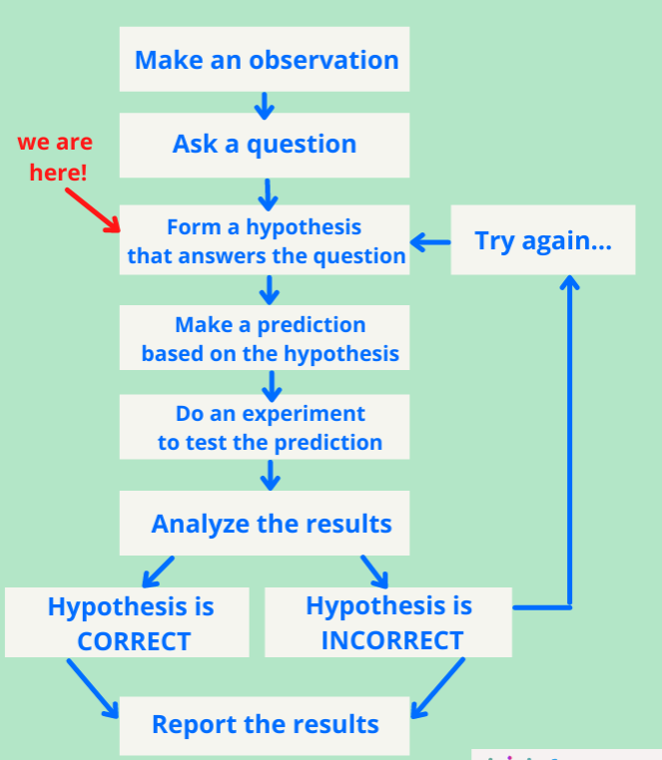
Hypothesis Testing
A statistical mechanism for decision making
Checks validity of a claim
Initially null hypothesis is assumed to be TRUE
It certain cases, it begins by making a tentative assumption about a population parameter based on rejecting the null hypothesis or accepting the alternate hypothesis

Slide 12
Example: Setting null and alternative hypotheses
Soft drink company filling 200 ml of soft drink in cans. The company hopes that the cans are averaging the quantity. A quality controller(QC) is worried that a machine is out of control and wants to conduct a hypothesis test to help determine whether that is true. The QC hopes the machine is functioning properly but is interested in finding whether machine is mal functioning and that result in different filling in bottles.
Null hypothesis: ??????
Alternative hypothesis : ?????????

Slide 13
Example: Setting null and alternative hypotheses
Soft drink company filling 200 ml of soft drink in cans. The company hopes that the cans are averaging the quantity. A quality controller(QC) is worried that a machine is out of control and wants to conduct a hypothesis test to help determine whether that is true. The QC hopes the machine is functioning properly but is interested in finding whether machine is mal functioning and that result in different filling in bottles.
The equality point is by default assigned to the null hypotheses.
One of the two hypotheses must exactly match the research question.

Slide 14
Example: Setting null and alternative hypotheses
Soft drink company filling 200 ml of soft drink in cans. The company hopes that the cans are averaging the quantity. A quality controller(QC) is worried that a machine is out of control and wants to conduct a hypothesis test to help determine whether that is true. The QC hopes the machine is functioning properly but is interested in finding whether machine is mal functioning and that result in different filling in bottles.
Null hypothesis (H0):
There is no problem in the machine and the mean value of the filled drink is 200 ml
Alternative hypothesis (H1) :
There is a problem in the machine and the mean value of the filled drink is not 200 ml

Slide 15
Example: Setting null and alternative hypotheses
Soft drink company filling 200 ml of soft drink in cans. The company hopes that the cans are averaging the quantity. A quality controller(QC) is worried that a machine is out of control and wants to conduct a hypothesis test to help determine whether that is true. The QC hopes the machine is functioning properly but is interested in finding whether machine is mal functioning and that result in different filling in bottles.
Null hypothesis: μ = 200 ml
Alternative hypothesis : μ ≠ 200ml

Slide 16
Example: Setting null and alternative hypotheses
Soft drink company filling 200 ml of soft drink in cans. The company hopes that the cans are averaging the quantity. A quality controller(QC) is worried that a machine is out of control and wants to conduct a hypothesis test to help determine whether that is true. The QC hopes the machine is functioning properly but is interested in finding whether machine is mal functioning and that is result in filling more capacity in bottles.
Null hypothesis: μ = 200 ml
Alternative hypothesis : μ > 200ml

Slide 17
Example: Setting null and alternative hypotheses
International business researcher who wants to test the hypothesis that manufacturing workers in Germany no longer receive an average of 30 vacation days per year.
Null hypothesis:
Alternative hypothesis :

Slide 18
Example: Setting null and alternative hypotheses
A recent survey of college campuses across Ontario claims that students spend an average of 2.7 hours a day using their cell phones. A random sample of 35 Durham college students showed an average use of 2.9 hours a day, with a standard deviation of 0.4 hours. Do Durham College students use their cell phones more than the typical Ontario college student?
Null hypothesis:
Alternative hypothesis :

Slide 19
Example: Setting null and alternative hypotheses
A recent survey of college campuses across India claims that students spend an average of 2.7 hours a day using their cell phones. A random sample of 35 SSN college students showed an average use of 2.9 hours a day, with a standard deviation of 0.4 hours. Do SSN College students use their cell phones more than the typical Indian college student?
Null hypothesis: μ = 2.7
Alternative hypothesis : μ>2.7

Slide 20
Inference after statistical experiments
 | Decision(from sample)
 | Status of hypotheses | Accept Null Hypothesis | Reject Null Hypothesis
Actual result | Null Hypothesis (True)
 | Null Hypothesis (False)

Slide 21
Inference after statistical experiments
 | Decision(from sample)
 | Status of hypotheses | Accept Null Hypothesis | Reject Null Hypothesis
Actual result | Null Hypothesis (True) | CORRECT DECISION
 | Null Hypothesis (False) |  | CORRECT DECISION

Slide 22
Inference after statistical experiments
 | Decision(from sample)
 | Status of hypotheses | Accept Null Hypothesis | Reject Null Hypothesis
Actual result | Null Hypothesis (True) | CORRECT DECISION | ERROR
 | Null Hypothesis (False) | ERROR | CORRECT DECISION

Slide 23
Inference after statistical experiments
 | Decision(from sample)
 | Status of hypotheses | Accept Null Hypothesis | Reject Null Hypothesis
Actual result | Null Hypothesis (True) | CORRECT DECISION | TYPE I ERROR (α)
 | Null Hypothesis (False) | TYPE II ERROR (β) | CORRECT DECISION

Slide 24
Choosing a better hypothesis
 | Decision(from sample)
 | Status of hypotheses | Accept Null Hypothesis | Reject Null Hypothesis
Actual result | Null Hypothesis (True) | CORRECT DECISION (1-α) | TYPE I ERROR (α) Level of Significance
 | Null Hypothesis (False) | TYPE II ERROR (β) | CORRECT DECISION (1- β) - Power of a Test

Slide 25
Choosing a better hypothesis
Level of significance is the probability of making a Type I error when the null hypothesis is true as an equality
Power of a test: Good test should reject null hypothesis when it is false
Good hypothesis test should reduce α and β
or
should have a high value of (1-β) or (1-α)

Slide 26
Decision Tests – Dependent on H1
A one-tailed test results from an alternative hypothesis which specifies a direction.
i.e. when the alternative hypothesis states that the parameter is in fact either bigger or smaller than the value specified in the null hypothesis.
A two-tailed test results from an alternative hypothesis which does not specify a direction.
i.e. when the alternative hypothesis states that the null hypothesis is wrong.

Slide 27
One-tailed test
A one-tailed test may be either left-tailed or right-tailed.
A left-tailed test is used when the alternative hypothesis states that the true value of the parameter specified in the null hypothesis is less than the null hypothesis claims.
A right-tailed test is used when the alternative hypothesis states that the true value of the parameter specified in the null hypothesis is greater than the null hypothesis claims

Slide 28
Keywords related to two-tailed tests
Confidence interval:
also known as the acceptance region,
It is a set of values for the test statistic for which the null hypothesis is accepted.
i.e. if the observed test statistic is in the confidence interval then we accept the null hypothesis and reject the alternative hypothesis.

Slide 29
Keywords related to two-tailed tests
Critical Region
Also known as the rejection region
It is a set of values for the test statistic for which the null hypothesis is rejected.
i.e. if the observed test statistic is in the critical region then we reject the null hypothesis and accept the alternative hypothesis.

Slide 30
Keywords related to two-tailed tests
Significance Levels:
Confidence intervals can be calculated at different significance levels.
We use α to denote the level of significance and perform a hypothesis test with a [100(1−α)]% confidence interval.
Confidence intervals are usually calculated at 5% or 1% significance levels, where α=0.05 and α=0.01 respectively.

Slide 31
Keywords related to two-tailed tests
Significance Levels:
Note that a 95% confidence interval does not mean there is a 95% chance that the true value being estimated is in the calculated interval. (It is not wrt the value)
Rather, given a population, there is a 95% chance that choosing a random sample from this population results in a confidence interval which contains the true value being estimated. (But, wrt the sample chosen)

Slide 32
Keywords related to two-tailed tests
Critical Values
It is a cut-off point
If a test statistic on one side of the critical value results in accepting the null hypothesis, a test statistic on the other side will result in rejecting the null hypothesis.

Slide 33
Keywords
z_{critical}
Rejection Region
Acceptance Region
α
z₂
z₁
μ₀
Reject H₀
Cannot Reject H₀

Slide 34
Two-tailed test
The main difference between one-tailed and two-tailed tests is that one-tailed tests will only have one critical region whereas two-tailed tests will have two critical regions.
If we require a 100(1−α)% confidence interval we have to make some adjustments when using a two-tailed test.

Slide 35
Two-tailed test
The confidence interval must remain a constant size, so if we are performing a two-tailed test, as there are twice as many critical regions then these critical regions must be half the size.
This means that when we read the tables, when performing a two-tailed test, we need to consider α/2 rather than α.

Slide 36
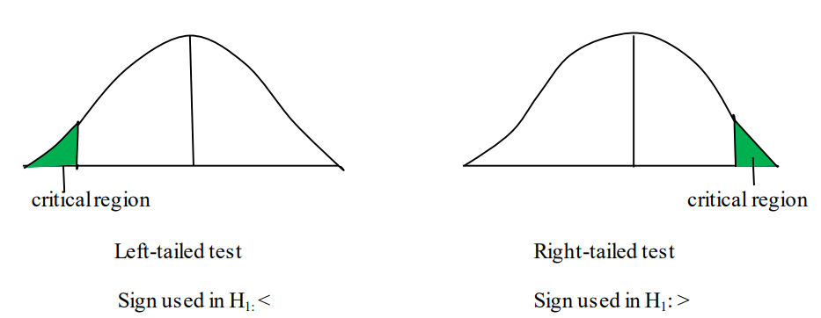
Decision rule – Depends on alternative hypothesis
If alternative hypothesis is directional then it is _______ test.

Slide 37
Decision rule – Depends on alternative hypothesis
If alternative hypothesis is directional then it is one tailed test

Slide 38
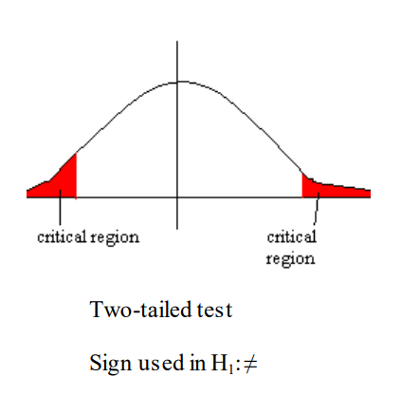
Decision rule – Depends on alternative hypothesis
If alternative hypothesis is non-directional then it is ________ test.

Slide 39
Decision rule – Depends on alternative hypothesis
If alternative hypothesis is non-directional then it is two tailed test

Slide 40
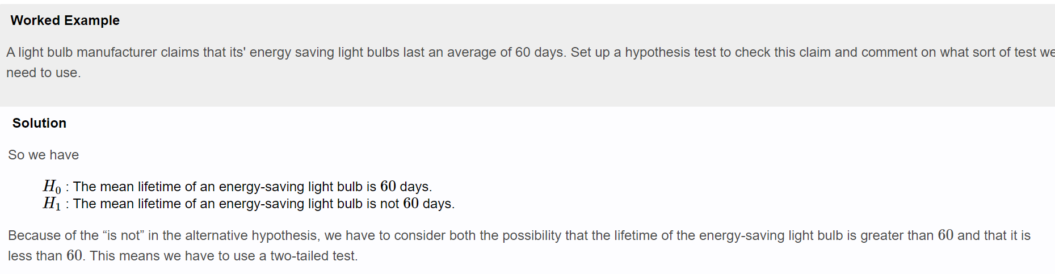
Example

Slide 41
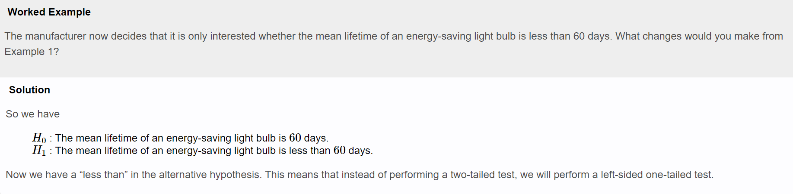
Example

Slide 42
Example
Find the critical values of the normal distribution using a 5% significance level for both a one-tailed and a two-tailed test.

Slide 43
Steps in Hypothesis Testing
State the Null Hypothesis
State the Alternative Hypothesis
Set α
Collect Data
Calculate a test statistic
Construct Acceptance / Rejection regions
Based on steps 5 and 6, draw a conclusion about H0

Slide 44
Understanding P value
P value indicates the maximum level of significance at which the null hypothesis is not rejected
Case 1:
if P >= α then H0 is not rejected or accepted
Case 2:
if P < α then H0 is rejected

Slide 45
Example
P value | α value | Status of H0
0.05 | <= 0.05
0.06 | <= 0.05
0.02 | = 0.05

Slide 46
Example
P value | α value | Status of H0
0.05 | <= 0.05 | Not rejected
0.06 | <= 0.05 | Not rejected
0.02 | = 0.05 | Rejected
If P≥α then H0 is not rejected

Slide 47
Books
TEXTBOOKS:
David Cielen, Arno D. B. Meysman, and Mohamed Ali, “Introducing Data Science”, Manning Publications, 2016. (first two chapters for Unit I).
Robert S. Witte and John S. Witte, “Statistics”, Eleventh Edition, Wiley Publications, 2017.
Jake VanderPlas, “Python Data Science Handbook”, O’Reilly, 2016.
REFERENCES:
Allen B. Downey, “Think Stats: Exploratory Data Analysis in Python”, Green Tea Press, 2014.

